Slide 1
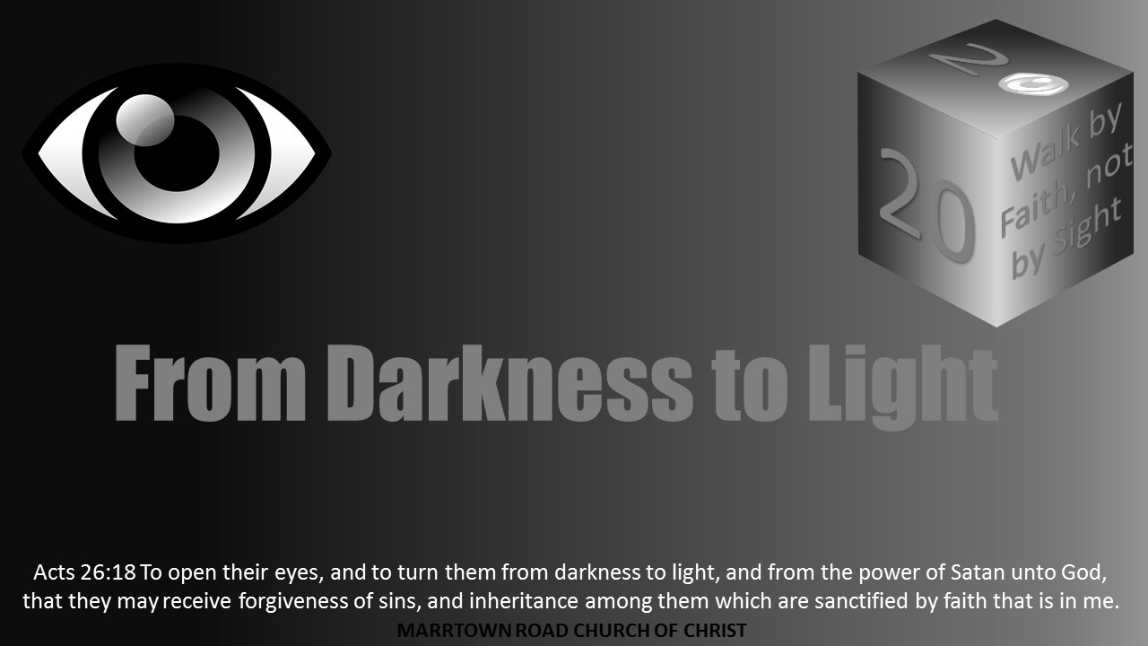


Slide 2
Light Lesson 1 A Story of Light: Part 1

Slide 3
In the Beginning, God Created Light
In the beginning at creation, God made light.
Genesis 1:3-4 reads, “And God said, Let there be light: and there was light. And God saw the light, that it was good: and God divided the light from the darkness.”
Life on Earth gets energy from the sun, mostly via photosynthesis.
The light is all around humanity in God’s creation.

Slide 4

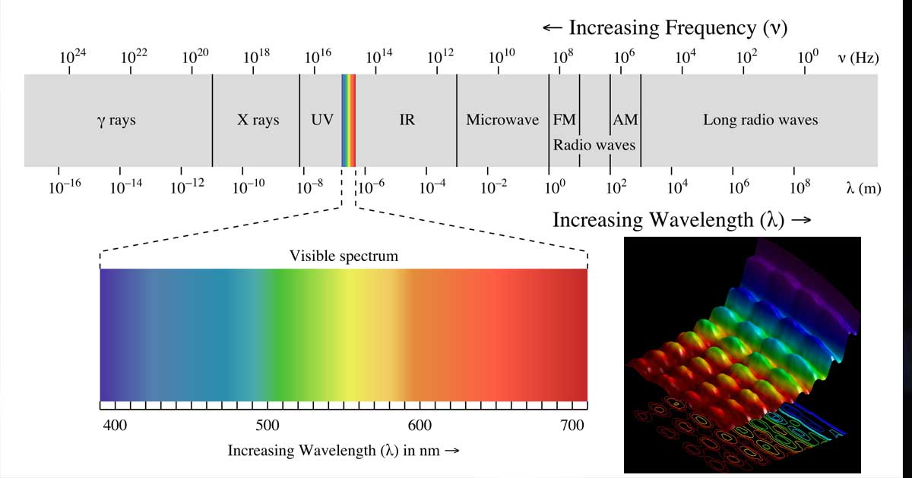
IN THE BEGINNING, GOD CREATED LIGHT
Today, scientists define light as the visible spectrum of electromagnetic radiation that humans register with eyes, about 390 to 700 nm.
It gives humans the beautiful colors seen.
Light travels at 2997922488 meters per second or 3.0x10⁸ m/s².
Light is fast but never hurried.
It is understood by science as a constant. It is steady, never resting or turning off.
It can travel vast distances as the stars demonstrate.
It silently brings energy to our noisy world. It is always quiet.

Slide 5
In the Beginning, God Created Light
When one watches a sunset, God’s palette of light dazzles the eyes and quietly mesmerizes the mind.
Joy often overwhelms the observer when beholding the rainbow of colors.
Most have caught themselves staring at their spouse or child and soaking the person into their heart.
Many spouses can recall specific occurrences when they felt a connection to their wife, husband, or their newborn as they soaked them in visually.
Christians need to spiritually see God and seek Him, becoming a partaker of the Divine Nature by God’s promises (2 Pet 1:3-4).

Slide 6
IN THE BEGINNING, GOD CREATED LIGHT
God has given humanity two lights in creation called the greater and lesser, or sun and moon, one reflecting the other.
In a hurry-up world, full of electric lights, many fail to observe the light of “Luna” during the night time.
Light pollution often prevents one from appreciating the stars.
Most humans, like most of creation, seek the light.
Sunflowers even turn toward the sun as it moves through the sky. Many flowers and other plant life grow and change to the sun.
Humans love to soak up the sun as well. The sunlight impacts humans.
Even a few low sunlight days in Winter will cause many to have “seasonal affective disorder.”
Humans make vitamin D when the sunlight hits their skin and receive a boost of energy from the sun.
Even in most of the blind, the sun impacts a person’s circadian rhythm of the sleep and wake cycle.

Slide 7
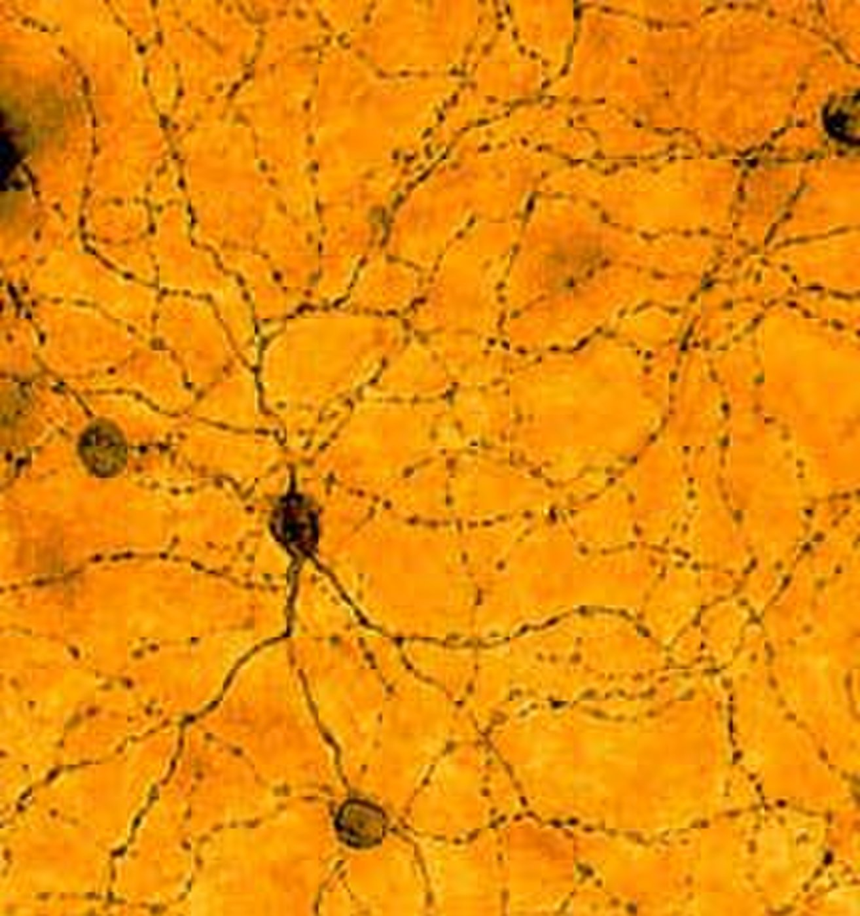
IN THE BEGINNING, GOD CREATED LIGHT
Within the last two decades, a new class of retinal cells has been identified.
These cells are non-image forming vision cells that impact the circadian system in the hypothalamus as well as other brain areas for regulation.
These cells are different from other photoreceptors because they communicate directly to the brain.
The intrinsically photosensitive retinal ganglion cells (ipRGC) carries a signal to the brain of light. Neurotransmitters are also proposed to change with sunlight exposure.
Even newer studies indicate that children who spend more time in the sunlight lessen their development of myopia or nearsightedness. (Photo of ipRGC by David Berson of Brown University)

Slide 8
IN THE BEGINNING, GOD CREATED LIGHT
Humans need and seek the light.
In the same way, the human soul yearning for the light of God as eternity is part of the human makeup (Eccl 3:11).
People who spend all their time indoors or in the dark suffer and tend to be less energetic and depressed.
Many similarly are not getting enough of the daily recommended dose of spiritual light from God’s word.
God’s light calls His saints to be holy as He is, beholding the splendor of His light in the darkness of the world.
Christians are to be “children of the light,” seeking to walk in the light (John 12:36, Eph 5:8, 1 Thess 5:5).
As His child, Christians want to carry and reflect His light and love.

Slide 9

IN THE GARDEN SATAN DECEIVES, EVE DISBELIEVES, AND ADAM DISOBEYS: EYES OPENED
Adam and Eve’s eyes were opened after they ate of the forbidden fruit in the Garden of Eden.
Not believing God, Eve was deceived by the serpent; and Adam chose to disobey God (1 Tim 2:14).
Genesis 3:4-7 records, “And the serpent said unto the woman, Ye shall not surely die: For God doth know that in the day ye eat thereof, then your eyes shall be opened, and ye shall be as gods, knowing good and evil. And when the woman saw that the tree was good for food, and that it was pleasant to the eyes, and a tree to be desired to make one wise, she took of the fruit thereof, and did eat, and gave also unto her husband with her; and he did eat. And the eyes of them both were opened, and they knew that they were naked; and they sewed fig leaves together, and made themselves aprons.”

Slide 10
IN THE BEGINNING, GOD CREATED LIGHT
Some have speculated that Adam and Eve’s eyes were physically changed.
However, most understand this to mean their understanding was opened.
Their fall opened their eyes of understanding.
They saw themselves as naked.
Sin separated them from the relationship they had with God.

Slide 11
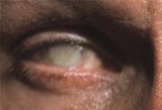
Eyes Darkened
From a relationship with God in the garden to being cast out, humanity’s eyes were darkened.
Satan had used the lust of the eyes, the lust of the flesh, and the pride of life on Eve.
He is still using this to blind the minds of people today.
2 Corinthians 4:3-6 instructs, “But if our gospel be hid, it is hid to them that are lost: In whom the god of this world hath blinded the minds of them which believe not, lest the light of the glorious gospel of Christ, who is the image of God, should shine unto them. For we preach not ourselves, but Christ Jesus the Lord; and ourselves your servants for Jesus' sake. For God, who commanded the light to shine out of darkness, hath shined in our hearts, to give the light of the knowledge of the glory of God in the face of Jesus Christ.”

Slide 12
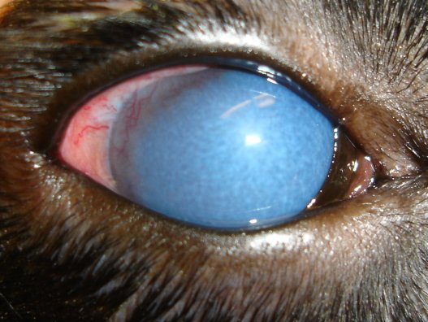
EYES DARKENED
Similarly, Israel’s eyes were blinded and darkened as Romans 11: 7-11 explains:
“What then? Israel hath not obtained that which he seeketh for; but the election hath obtained it, and the rest were blinded (According as it is written, God hath given them the spirit of slumber, eyes that they should not see, and ears that they should not hear;) unto this day. And David saith, Let their table be made a snare, and a trap, and a stumbling block, and a recompence unto them: Let their eyes be darkened, that they may not see, and bow down their back always.”

Slide 13
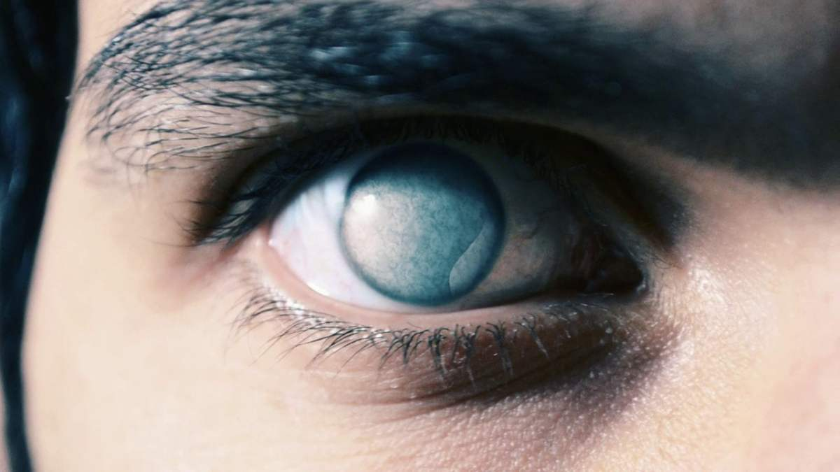
EYES DARKENED
The Gentiles were also blinded and darkened by Satan as Ephesians 4:17-19 explains:
“This I say therefore, and testify in the Lord, that ye henceforth walk not as other Gentiles walk, in the vanity of their mind, Having their understanding darkened, being alienated from the life of God through the ignorance that is in them, because of the blindness of their heart: Who being past feeling have given themselves over unto lasciviousness, to work all uncleanness with greediness.”

Slide 14
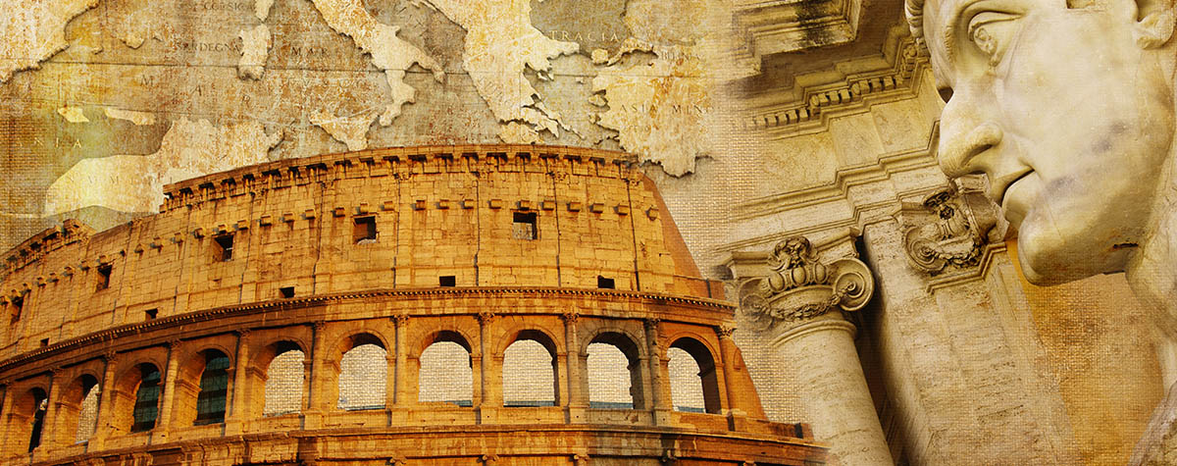
EYES DARKENED
From the Garden of Eden to now, both Jews and Gentiles have had their eyes darkened because of Satan’s lies.
Today, American society is very much a Romans 1 culture, such that the culture’s eyes are darkened.
Romans 1:20-22 explains, “For the invisible things of him from the creation of the world are clearly seen, being understood by the things that are made, even his eternal power and Godhead; so that they are without excuse: Because that, when they knew God, they glorified him not as God, neither were thankful; but became vain in their imaginations, and their foolish heart was darkened. Professing themselves to be wise, they became fools….”
From Adam and Eve to Israel to the Gentiles to today, Satan has darkened the eyes of humanity with versions of the lies from the Garden of Eden.

Slide 15
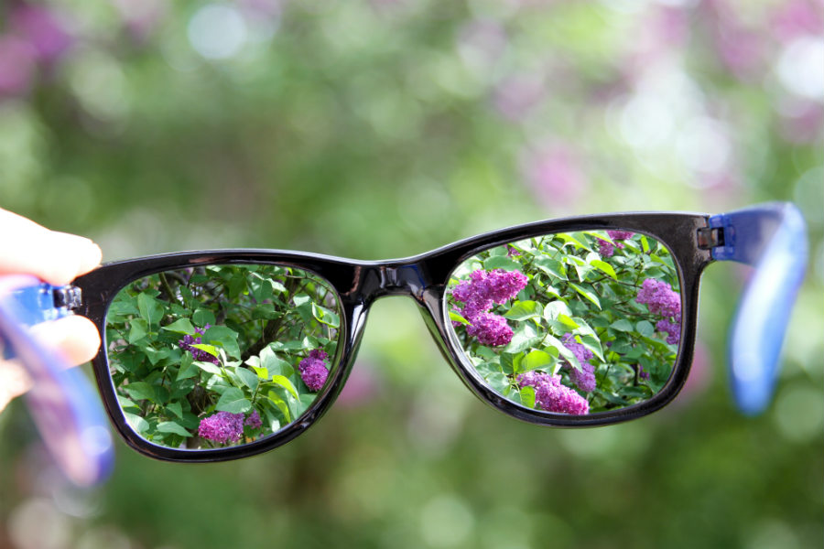
Coming into Focus
Humans are designed to see.
The brain and eyes are incredibly designed.
When the eye cannot move properly, optometrists use prisms to move an image or the light to an eye.
From a spiritual standpoint, one might call the capacity to turn from the carnal to the spiritual an “eternal prism” or “lens of faith” that is focused on Christ and the eternal, seeing the unseen.
Satan often blinds with the lenses of sin. These are distractions, distortions, and lies that he uses to draw souls away from Yahweh.
Humanity’s spiritual eyes or understanding is blinded by Satan’s lies. Christians must learn to see through the eternal prism or lens of faith, looking to the spiritual rather than the flesh to focus on Christ.

Slide 16
COMING INTO FOCUS
When a child is born, it still must learn to see.
Newborns with perfectly normal eyes learn to focus and attend to things.
The mind and eyes continue to learn and to become part of human function.
In folks who have gained sight after having lost it as a child, they often are still very lost visually when they receive their sight. They do not know what to do with the information they “see.”
One interviewer asked such a person what an object in his hand was. The newly sighted person knew it was red. He had seen and had identified a red coke can earlier in the interview. He guessed, “Coke can.” He could not tell the interviewer that the object was a rose.
People learn to see.

Slide 17
COMING INTO FOCUS
Like physical sight, Christians must learn to see spiritually.
It takes time to change our thinking.
“Children of light” are transformed into the image of Christ (Rom 12:1-2) by the renewing of their minds.
When sin is part of one’s lives, it obfuscates their vision.

Slide 18
COMING INTO FOCUS
1 John 1:7-8 instructs, “But if we walk in the light, as he is in the light, we have fellowship one with another, and the blood of Jesus Christ his Son cleanseth us from all sin. If we say that we have no sin, we deceive ourselves, and the truth is not in us.”
Satan often dazzles humans with the sin of a temporary trinket or flashing toy.
Christians must return to the true Light found through God’s word to grow and focus on Christ.

Slide 19
COMING INTO FOCUS
God seeks to set a light ablaze in the human heart so we might carry His light to others.
The Psalmist expresses it this way: “For thou wilt light my candle: the LORD my God will enlighten my darkness.”

Slide 20
COMING INTO FOCUS
Paul in 1 Corinthians 13:12 writes, “For now we see through a glass, darkly; but then face to face: now I know in part; but then shall I know even as also I am known.”
Paul taught that eventually, “children of light” will see clearly as though face to face.
He explains in 2 Corinthians 3:13-18, “And not as Moses, which put a vail over his face [after coming down from the mountain where God was], that the children of Israel could not steadfastly look to the end of that which is abolished: But their minds were blinded: for until this day remaineth the same vail untaken away in the reading of the old testament; which vail is done away in Christ. But even unto this day, when Moses is read, the vail is upon their heart. Nevertheless when it shall turn to the Lord, the vail shall be taken away. Now the Lord is that Spirit: and where the Spirit of the Lord is, there is liberty. But we all, with open face beholding as in a glass the glory of the Lord, are changed into the same image from glory to glory, even as by the Spirit of the Lord.”

Slide 21
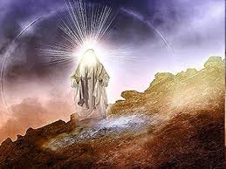
COMING INTO FOCUS
Moses face glowed after the Lord hid him in the cliff of the rock and covered Moses with His hand, but saw God’s back parts, not His face (Exod 33:21-33).
When Moses spoke to the Israelites, his face glowed, and he wore a vail (Exod 34:33-35).
Now, God's children see in reflection the glory of God and are changed into the same image to glory.

Slide 22
Keeping Focus on Christ and God
As Christians learn to see spiritually, they become focused on seeking God and His righteousness.
In Matthew 6:22-23, Jesus teaches, “The light of the body is the eye: if therefore thine eye be single, thy whole body shall be full of light. But if thine eye be evil, thy whole body shall be full of darkness. If therefore the light that is in thee be darkness, how great is that darkness!”
The idea of “single” is sometimes translated as “clear” or “healthy” but this author might suggest is better communicated as “focused.”

Slide 23
KEEPING FOCUS ON CHRIST AND GOD
When one’s focus is locked on the light of Christ, then the whole body is full of light.
In John 8:12 Jesus taught, “Then spake Jesus again unto them, saying, I am the light of the world: he that followeth me shall not walk in darkness, but shall have the light of life.”
Jesus is the light of life.
In Matthew 6:33, He teaches His followers to focus on the kingdom of God and His righteousness first. All these other worries of life fade as one’s focus is on God.

Slide 24
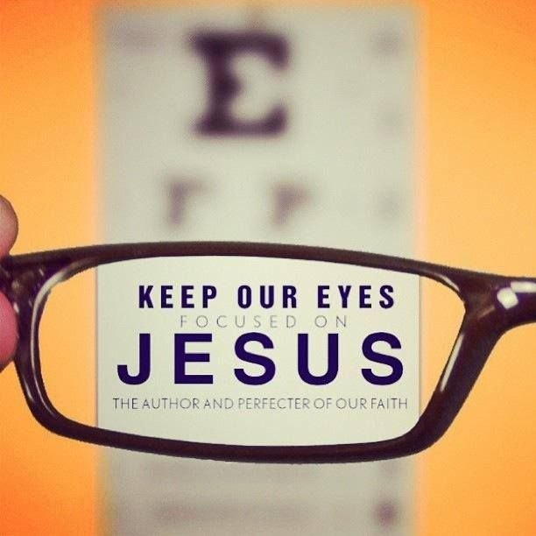
KEEPING FOCUS ON CHRIST AND GOD
Hebrews 12:1 encourages, “Wherefore seeing we also are compassed about with so great a cloud of witnesses, let us lay aside every weight, and the sin which doth so easily beset us, and let us run with patience the race that is set before us, Looking unto Jesus the author and finisher of our faith; who for the joy that was set before him endured the cross, despising the shame, and is set down at the right hand of the throne of God.”
Christians must learn to see spiritually or transform to be image bearers of God’s light by being renewed from His word, keeping their eye on Christ.

Slide 25
KEEPING FOCUS ON CHRIST AND GOD
Christians must take care to set aside the many encumbering sins of this life as Hebrew 12 encourages.
Too often, one is unstable because they are not focused on God but are double minded.
James warns Christians to be clear.
“But let him ask in faith, nothing wavering. For he that wavereth is like a wave of the sea driven with the wind and tossed. For let not that man think that he shall receive any thing of the Lord. A double minded man is unstable in all his ways” (James 1:6-8).
It is easy to be distracted by things in this life and take one’s eye off the goal of seeking God and following Jesus.

Slide 26
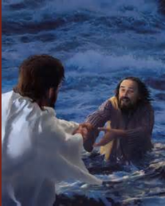
KEEPING FOCUS ON CHRIST AND GOD
In Matthew 14, Jesus bids Peter to walk to Him on the water, but Peter took his eyes off Jesus. He focused fearfully and doubtfully on the storm and began to sink.
Matthew 14:30-31 records, “And he said, Come. And when Peter was come down out of the ship, he walked on the water, to go to Jesus. But when he saw the wind boisterous, he was afraid; and beginning to sink, he cried, saying, Lord, save me. And immediately Jesus stretched forth his hand, and caught him, and said unto him, O thou of little faith, wherefore didst thou doubt?” Jesus warned all not to look back. Luke 9:62 explains,” And Jesus said unto him, No man, having put his hand to the plough, and looking back, is fit for the kingdom of God.”
Christians must focus on God and His righteousness.

Slide 27

Men as Trees
Jesus healed the blind man on the way to Bethsaida.
Mark uniquely records this in 8:22-25, “And he cometh to Bethsaida; and they bring a blind man unto him, and besought him to touch him. And he took the blind man by the hand, and led him out of the town; and when he had spit on his eyes, and put his hands upon him, he asked him if he saw ought. And he looked up, and said, I see men as trees, walking. After that he put his hands again upon his eyes, and made him look up: and he was restored, and saw every man clearly.”
Jesus healed this way intentionally as Mark recorded it.
Although the reason is not explicitly stated, it was not some failure on Jesus ability to heal. The text is making a point.

Slide 28
MEN AS TREES
Earlier in 8:17-18 Jesus asks the disciples, “And when Jesus knew it, he saith unto them, Why reason ye, because ye have no bread? perceive ye not yet, neither understand? have ye your heart yet hardened? Having eyes, see ye not? and having ears, hear ye not? and do ye not remember?”
So why did Jesus heal the man in Mark 8 in two parts?
Jesus gave the blind man eyes, but he still could not see.
This is common in today’s world as well, which is fortunate for me as an optometrist.
However, as a parent, I have lost my calm collective with my sons when asking them how they do not get an idea that I have pounded into their thinking. “Why do you not understand?”

Slide 29
MEN AS TREES
Jesus was clearly making a subtle point with the previous discussion in the healing.
Even now, many have great eyes and bad vision, while others have bad eyes and great vision.
Many see but do not see or understand clearly.
Jesus demonstrates that He gives everyone what they need as individuals, either great events or hard events to help one mature spiritually.
God is just but treats each person individually.
That is hard at times for humans to grasp. God does not treat everyone the same way, but rather as individuals. Many have seen it with their own kids as one child has reached a point where a reward or recognition was ready for one but not the other. At this point, sibling rivalry sometimes surfaces. Humans as clay do not get to grumble to the Potter about how He chooses to use the lives He has given. He has promised Christians the important part in eternity as His children. Often, as folks are older, they realize what they thought was horrible in their lives was actually a blessing in disguise. God deals with all according to individual needs.

Slide 30
MEN AS TREES
Christians all grow and spiritually mature differently.
Some struggle to make their vision clear or get distortion from other things in life.
Most people have areas of blurry vision spiritually -- even blind spots.
Often Christians are impatient children of God. Christians pray for God to give them patience right now. Unfortunately, it usually does not work out that way.
Children of light obey starting as babes in Christ, as little children, they mature through stages as they learn and grow.
Children of God learn to walk in the faith often by trying, falling, and retrying.

Slide 31

MEN AS TREES
Often we see more mature individuals rush new converts with an expectation that they should move along and catch up. More mature Christians need to be careful of too great of expectations.
At the same time, Christians cannot stay as babes but must grow and seek God, even when their transformation is not as fast or as more mature children of God might like.
If we are a Christian and recognize spiritual blindness in others, then we must seek God to help them see.
2 Peter 1 instructs us to be diligent to add virtue, knowledge, self-control, patience, godliness, brotherly kindness, and love to their faith.
2 Peter 1:8-9 explains the result, “For if these things be in you, and abound, they make you that ye shall neither be barren nor unfruitful in the knowledge of our Lord Jesus Christ. But he that lacketh these things is blind, and cannot see afar off, and hath forgotten that he was purged from his old sins.”

Slide 32
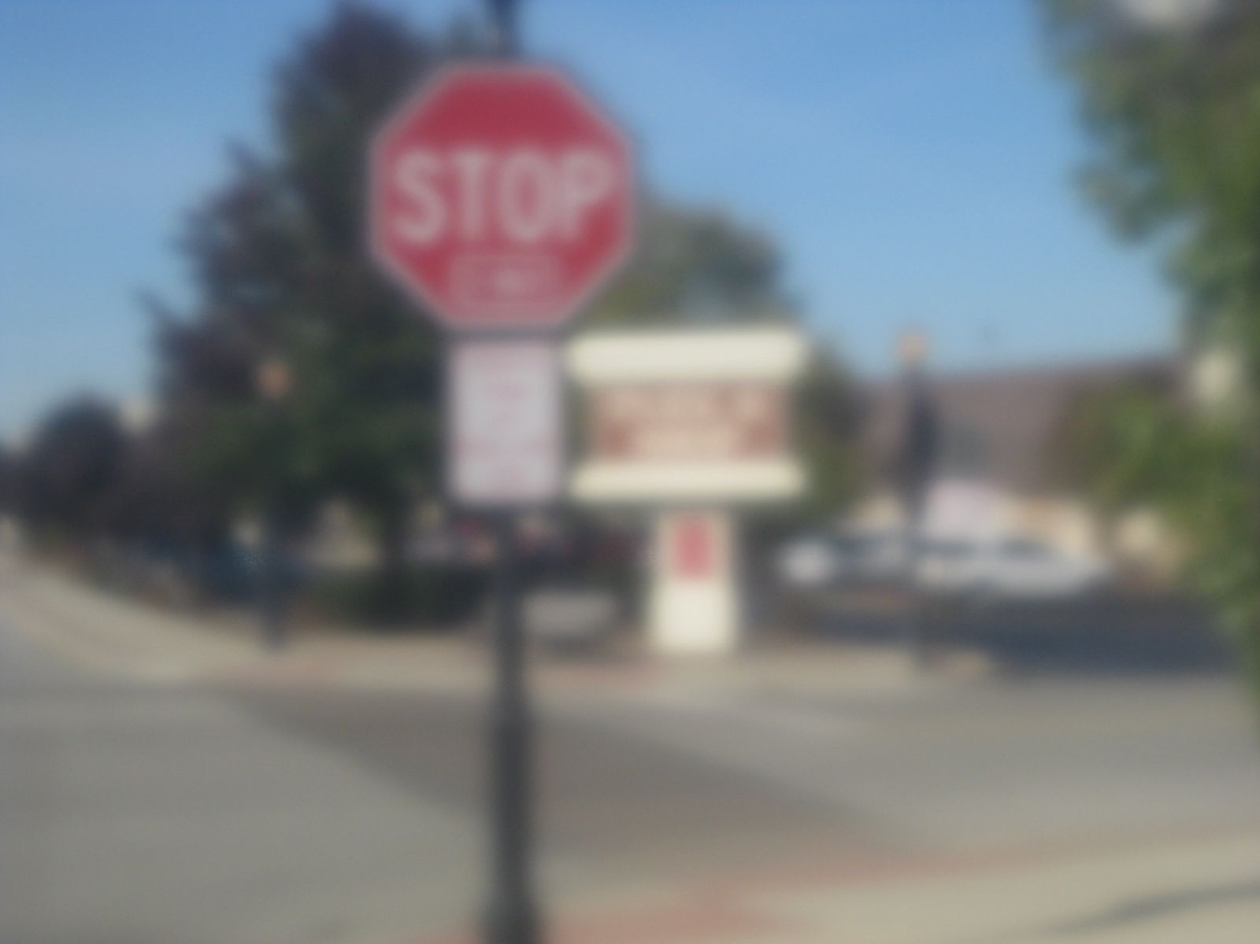
MEN AS TREES
Nearsightedness or myopia means one cannot see off in the distance.
These characteristics or graces in 2 Peter 1 are part of the Christian's armor of light and are what one might call “spiritual myopia and blindness control.”
If Christians exercise these, then they will not be myopic or blind.
God will make use of those who submit to His righteousness, bringing fruit and goodness from them in His kingdom.
Myopic View

Slide 33
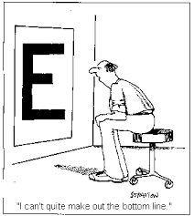
MEN AS TREES
The man at Bethsaida in Mark 8 was joyful at what he could see. “I see men as trees.”
Seeing the 20/400 big “E” on the chart is not 20/20, but it is exciting when before all one could see was blackness.
He was also open with his lack.
Children of God must be open with their faults and weakness -- blind, blurry, or whatever, in such cases, we must take ourselves to the great Healer.

Slide 34
MEN AS TREES
Christians must confess their sin to God as well as each other (1 John 1:9, James 5;16).
Confession seems to be very neglected in this time.
Sometimes, it is difficult for a person to admit their inabilities to see spiritually and to express weakness or vulnerability.
God can help His children, but they need to be open and direct about where they are struggling.

Slide 35
MEN AS TREES
Too often folks lament struggling with sin when they are in fact snuggling sin. These two words are but two letters different.
Struggle tries to express a smidge of guilt. However, many times, even those in the church are far more comfortable snuggling with sin than struggling to escape its corruption.
In this healing of the blind man, Jesus was calling His disciples back to Mark 8 where despite having eyes, they did not see. He used the man at Bethsaida to make a subtle point.

Slide 36
Conclusion
In the beginning, God created light. God is light.
Light is multifaceted and many splendored. It is quiet, unhurried, and powerful.
Since the Garden of Eden, Satan has been deceiving humanity's eyes and ears with his lies, such that human eyes are darkened.
Christ came to cure spiritual blindness and open eyes to see the spiritual rather than the temporal.
Once one can focus and make their eyes “single” (See Mt 6:22 and Lk 11:39), then these “children of light” must keep their focus on Christ and God.
Jesus healed the blind then, and He cures spiritual blindness now. The story of light continues in Lesson 2.

